Slide 1
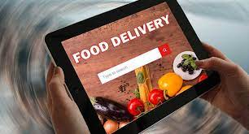
Online Food Delivery System
Submitted by,
G.Iyswariya-7943

Slide 2
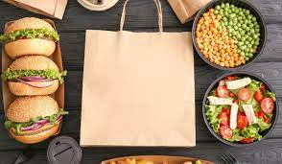
AGENDA
Introduction
Java Fullstack
Food Delivery Services
Order process
Flow chart
Advantages of a food delivery service
Disadvantages of a food delivery service
Screenshots

Slide 3
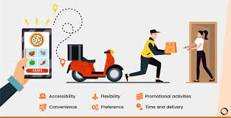
Introduction
Online food ordering is the process of ordering food, for delivery or pickup, from a website or other application. The product can be either ready-to-eat food (e.g., direct from a home-kitchen, restaurant, or a virtual restaurant) or food that has not been specially prepared for direct consumption (e.g., vegetables direct from a farm/garden, fruits, frozen meats. etc).
Online food ordering/delivery through third-party companies have emerged as a global industry, leading to a "delivery revolution.

Slide 4

JAVA FULLSTACK
FRONT END:

Slide 5



BACK END:

Slide 6
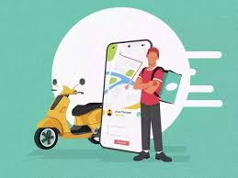
who invented online food delivery?
The first online food order was a pizza from Pizza Hut in 1994.

Slide 7
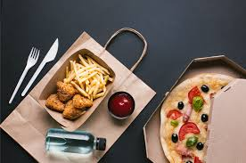
History of Food delivery
The first online food order was a pizza from Pizza Hut in 1994.
By 2015, online ordering began overtaking phone ordering.
In 2015, China's online food ordering and delivery market grew from 0.15 billion yuan to 44.25 billion yuan.
After 2020, COVID-19 significantly boosted online food delivery usage world wide.

Slide 8
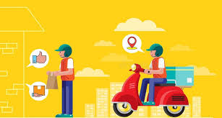
What is Food Delivery Service?
A restaurant, prepared food shop, or fast food establishment, in which the principal use is production of prepared food for delivery to customers located off the business premises.

Slide 9
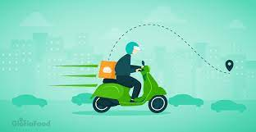
How does food delivery works?
Food delivery service is somewhat similar to courier service in which the ordered food is delivered from the restaurant to the customer either by the restaurant's staff or by delivery agents of a food ordering company. This obviously depends on the medium through which a customer places their order.

Slide 10
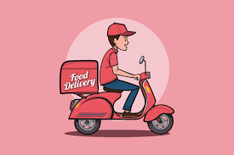
Why do people use food delivery?
People who are continuously busy with work but want to eat something delicious have found food delivery services to be a lifesaver.
People no longer have to bother about food preparation because they can order from a variety of restaurants and food providers using their mobile phones or computers.

Slide 11
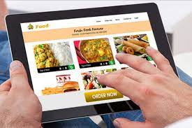
Why food delivery is the future?
Another reason why the future of online food ordering and delivery is now the way it is simply comes down to restaurants changing their business models to resemble retail. Same-hour and same-day delivery all play into the always-connected lifestyles of the modern consumer.

Slide 12
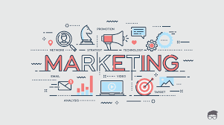
Food Delivery App Marketing Plan
Do research.
Promote the app on your website.
Optimize your app store listing.
Treat email subscribers to a sneak peek.
Post about the app on social media.
Create an in-app loyalty program.
Send notifications with special offers and promotions.
Consider paid ads.

Slide 13
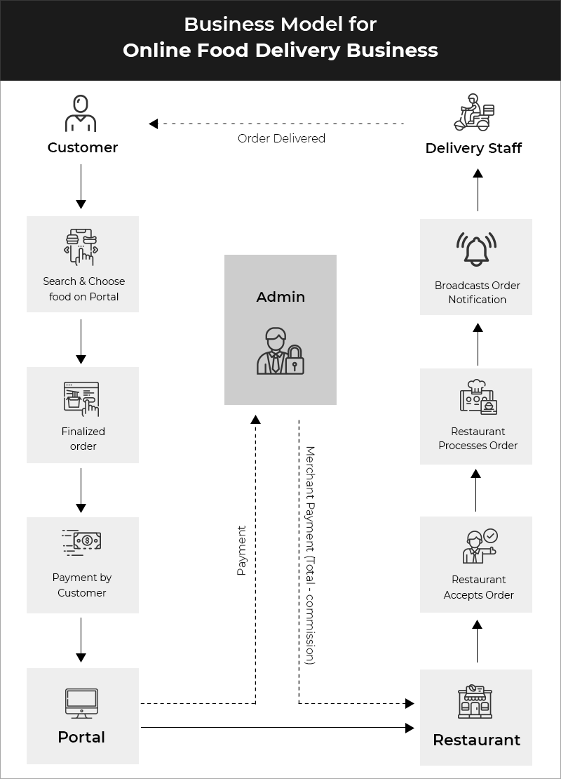
Ordering Process:

Slide 14
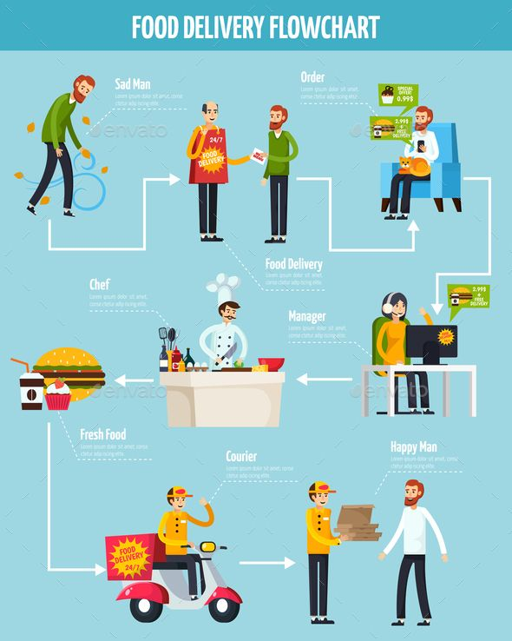
Flow Chart:

Slide 15
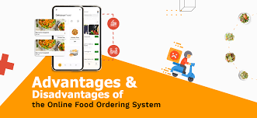

Slide 16
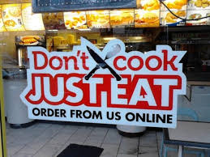
What are the 7 advantages of a food delivery service?
Ordering process is easy.
Exposure to new customers.
.Online ordering is convenient.
More business opportunities.
Stay ahead of the competition.
Greater reach.
Better customer data.

Slide 17
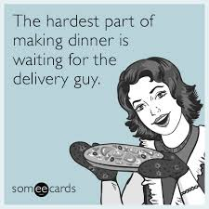
Disadvantages of Food Delivery Services:
Quality of food may suffer.
Food delivery services are often late.
Food may get cold.
Not the same personal touch as in a restaurant.
Person who delivers food may not be trustworthy.
Food delivery may cost some money.
You may get lazy.

Slide 18
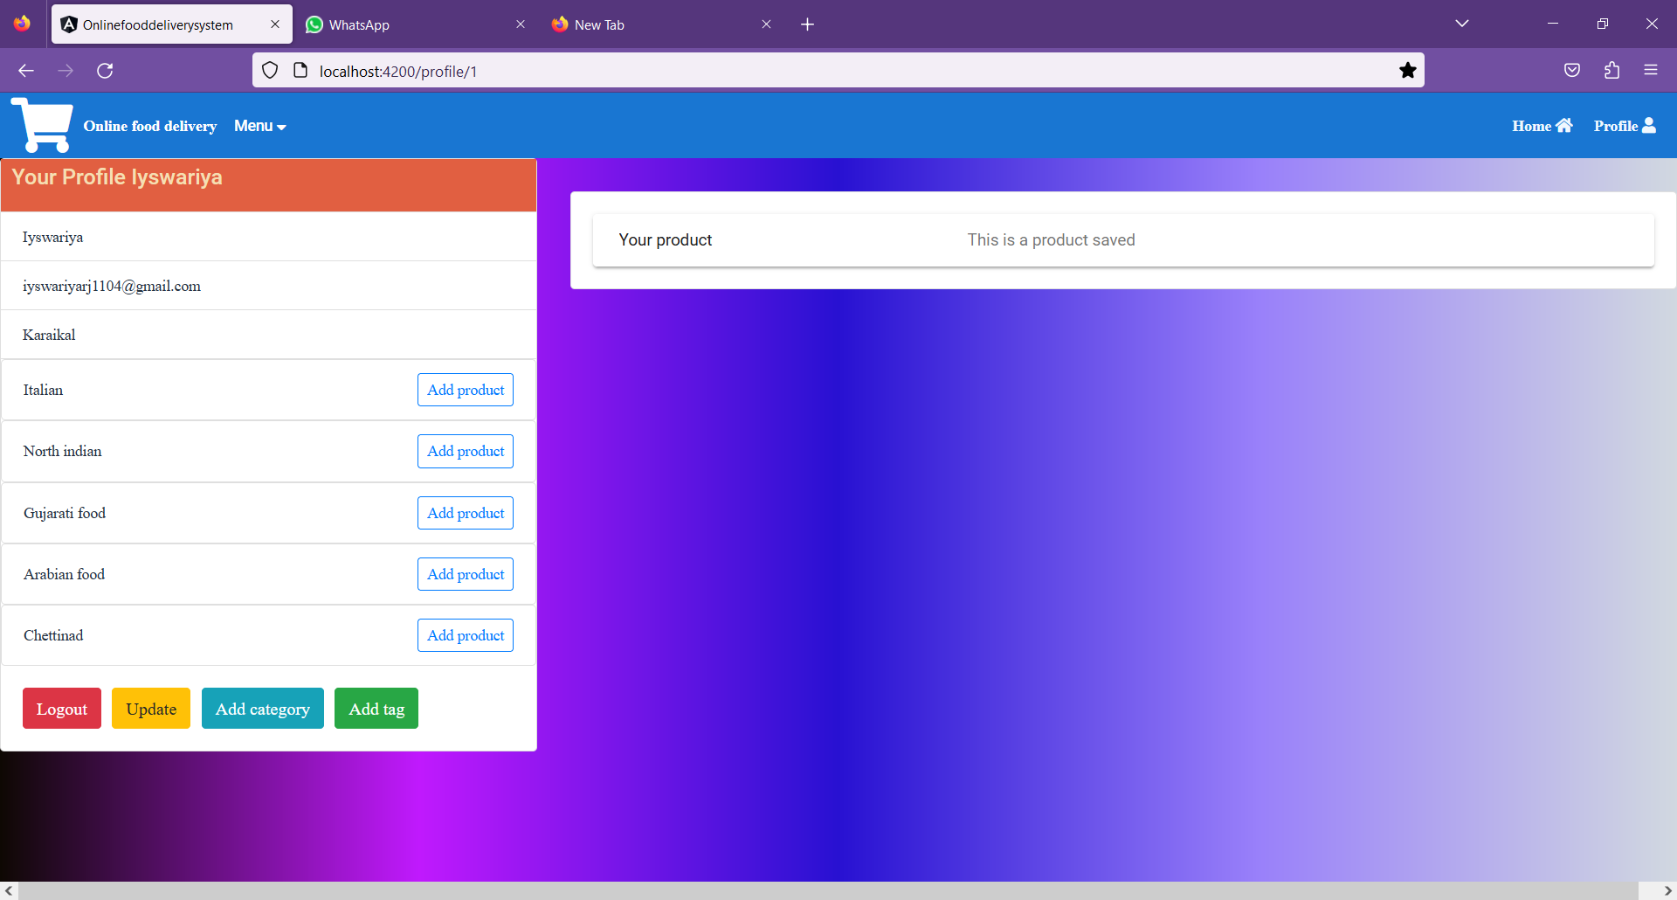
Screenshot(Main page):

Slide 19
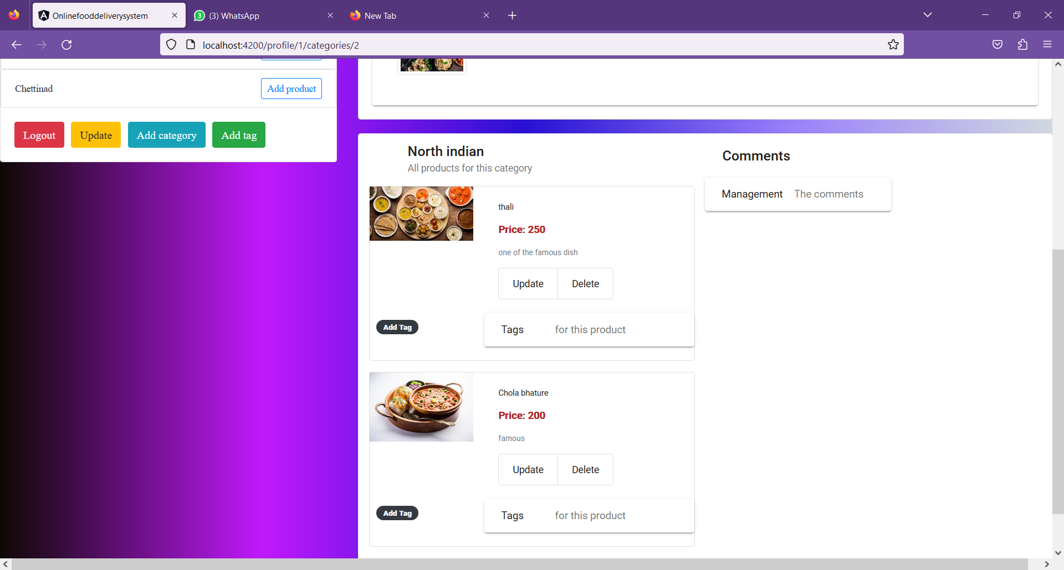

Slide 20
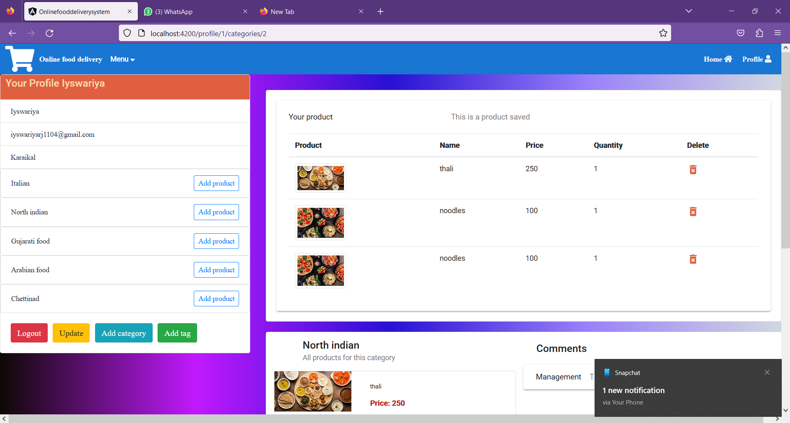

Slide 21
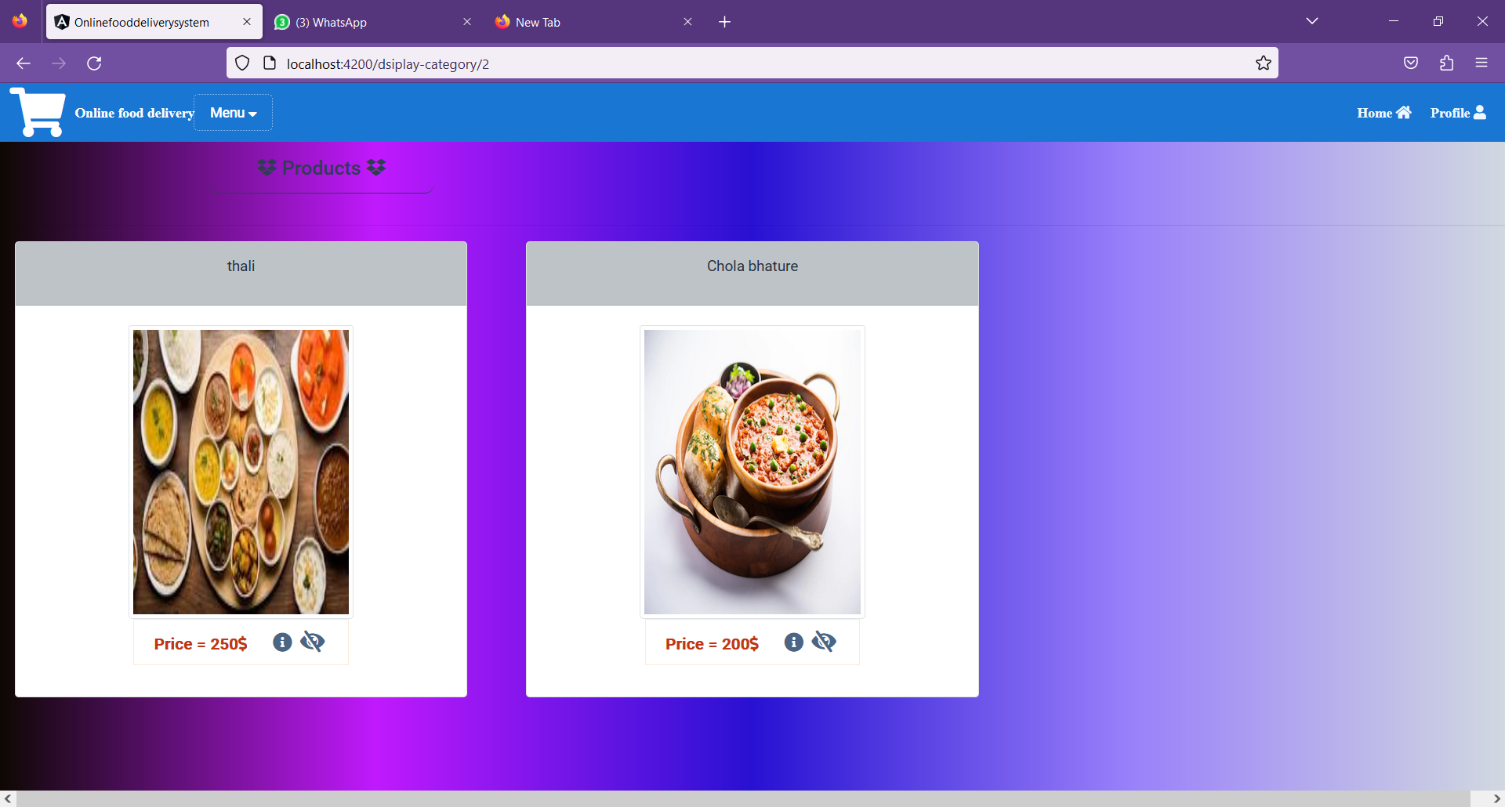
Product page:

Slide 22
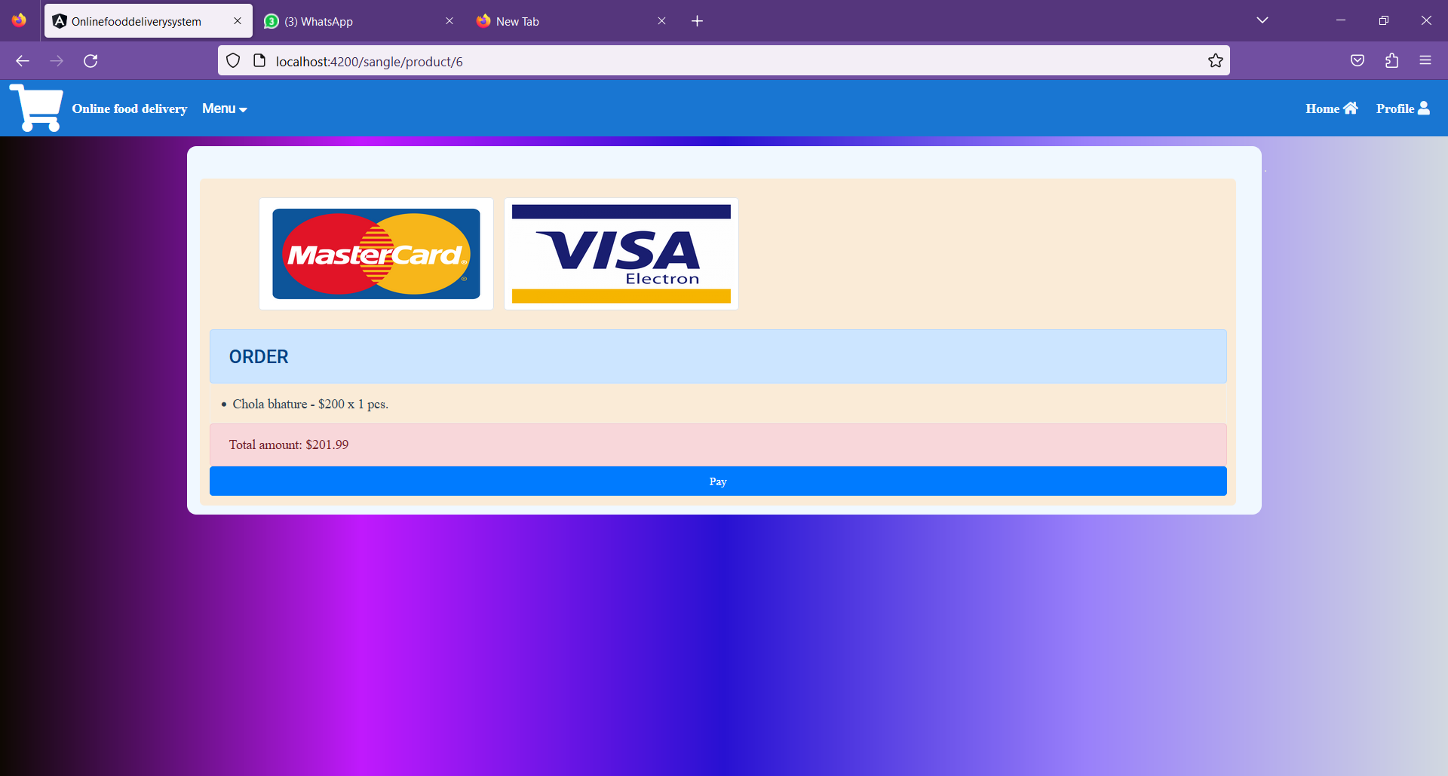
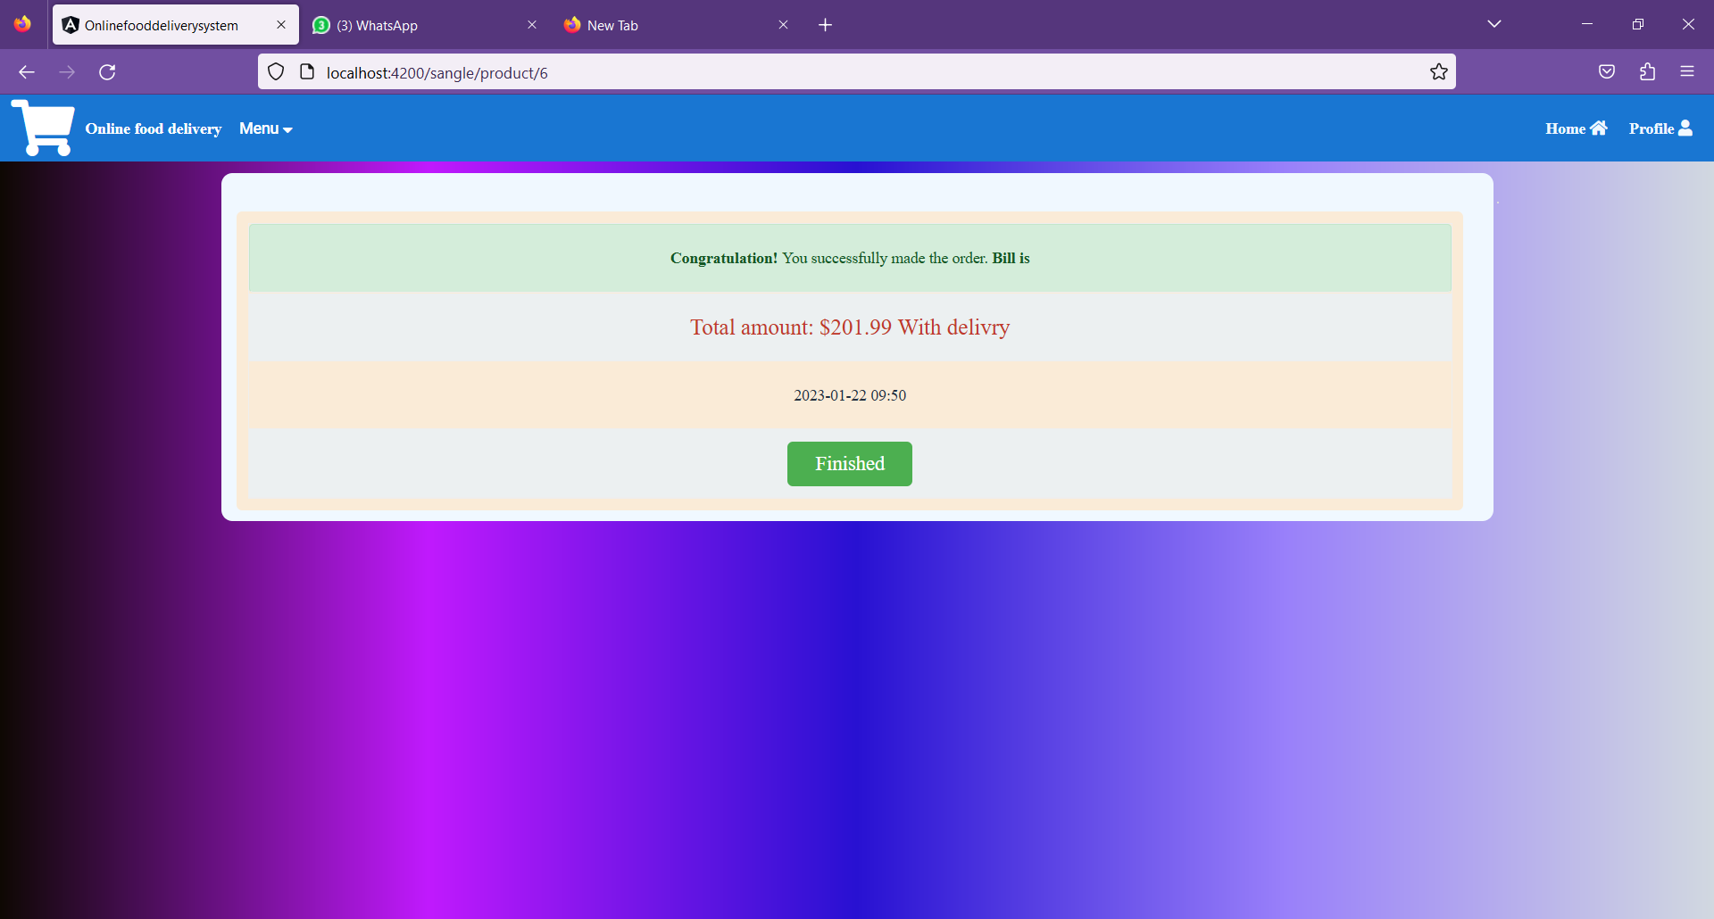
Payment page:

Slide 23
